Slide 1
IE7275 Data Mining in Engineering Spring 2024
Project Presentation
City Crimes Classification as Violent or Non-Violent using Supervised Machine Learning Algorithms
-By
Manikandan Mohan
02242414

Slide 2
Index
Problem Statement and Objective
Dataset and Features
Data Loading and Overview
Analysis of Features – EDA
Data Cleaning and Pre-processing
Feature Selection
Model Creation and Evaluation
Hyperparameter Tuning – Optimizing Model Parameters
Random Forest – Tuned for Precision
Confusion Matrix – Tuned Random Forest
ROC Curve – Tuned Random Forest
Conclusion

Slide 3
Problem Statement and Objective
Aim of the Project:
The project aims to use the Los Angeles Crime dataset from 2024 to present and classify the Crime Type based on the various features present in the dataset.
To utilize advanced machine learning techniques to understand crime patterns and predict whether a crime is violent (harming people) or non-violent crimes.
Methodological Approach:
Comprehensive analysis of crime data.
Strategic feature selection for algorithm optimization.
Evaluation of Predictive Algorithms: Identify the most effective ML models for crime type classification.
Fine-tuning models to improve predictive accuracy.
Evaluating the dataset with best model and its best parameters

Slide 4


Outcome for Law Enforcement:
Enable data-driven decision-making and Optimize resource allocation based on the type of the crime that has been reported.
Ultimate Goal is to strengthen safety in the city by helping to identify Violent Crimes and assist in proactive policing efforts.

Slide 5
DATASET AND FEATURES
The dataset is sourced from data.gov and it has crimes occurred in LA, CA from 2024 to present and it has 29,106 rows and 35 features.
DR_NO: Report number
Date Rptd: Date reported
DATE OCC: Date of occurrence
TIME OCC: Time of occurrence
AREA: Area code
AREA NAME: Name of the area
Rpt Dist No: Reporting district number
Part 1-2: Part 1 or 2 crimes (Based on FBI Uniform Crime Reporting classification)
Mocodes: Modus operandi codes
LOCATION: Location of the crime
Cross Street: Cross street
Vict Age: Victim's age
Vict Sex: Victim's sex
Vict Descent: Victim's descent
Premis Cd: Premise code
Premis Desc: Premise description
Weapon Used Cd: Weapon used code
Weapon Desc: Weapon description
Status: Case status
Status Desc: Status description
Crm Cd 1: Primary crime code
Crm Cd 2: Secondary crime code
Crm Cd: Crime code
Crm Cd Desc: Crime code description
Crm Cd 3: Tertiary crime code
Crm Cd 4: Quaternary crime code
LAT: Latitude
LON: Longitude
Rptd Day: Reported day
Rptd Month: Reported month
Rptd Year: Reported year
OCC Day: Occurrence day
OCC Month: Occurrence month
OCC Year: Occurrence year
Crime Type: Type of crime

Slide 6
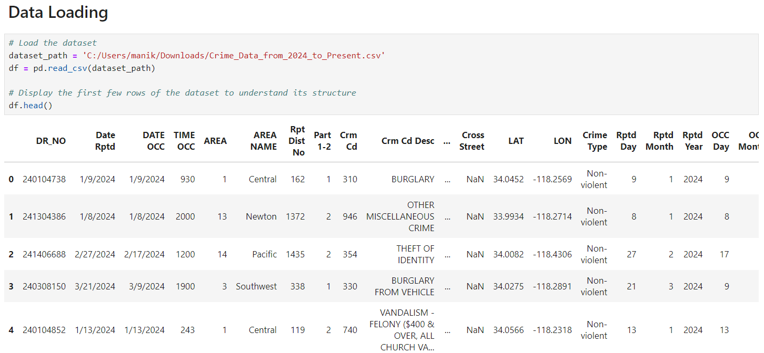
DATA LOADING AND OVERVIEW
Dataset Overview: Extensive crime data suitable for pattern recognition and predictive modeling.
Data Preprocessing: Identified missing values require careful data cleaning for analysis readiness.
Feature Richness: Varied features present, aiding in the understanding and prediction of crime types.
Statistical Summary: Victim age and crime timing highlight demographic and temporal crime patterns.
Analysis Pathway: To proceed with feature engineering, in-depth exploratory analysis, and model development.

Slide 7
Data Cleaning and Pre-Processing
Dropped columns with over 50% missing data to streamline dataset (Crm Cd 2, 3, 4, Cross Street).
Removed DR_NO as it adds no predictive value to crime classification.
Filled missing Weapon Desc and Codes with 'UNKNOWN WEAPON/OTHER WEAPON' and 500.
Missing Vict Sex and Descent marked as 'X' for 'Unknown' to maintain dataset completeness.
Assigned '9999' for missing Mocodes to categorize non-distinctive MOs.
Deleted rows with remaining nulls post-column-specific cleaning to ensure dataset completeness.
Corrected victim age anomalies using median age for a realistic demographic profile.
Dates (Date Rptd, DATE OCC) converted to datetime; extracted day and month for focused time analysis.
Dropped LOCATION text in favor of LAT and LON for precise geospatial modeling.
Eliminated descriptive text columns, utilizing corresponding codes for streamlined quantitative analysis.

Slide 8
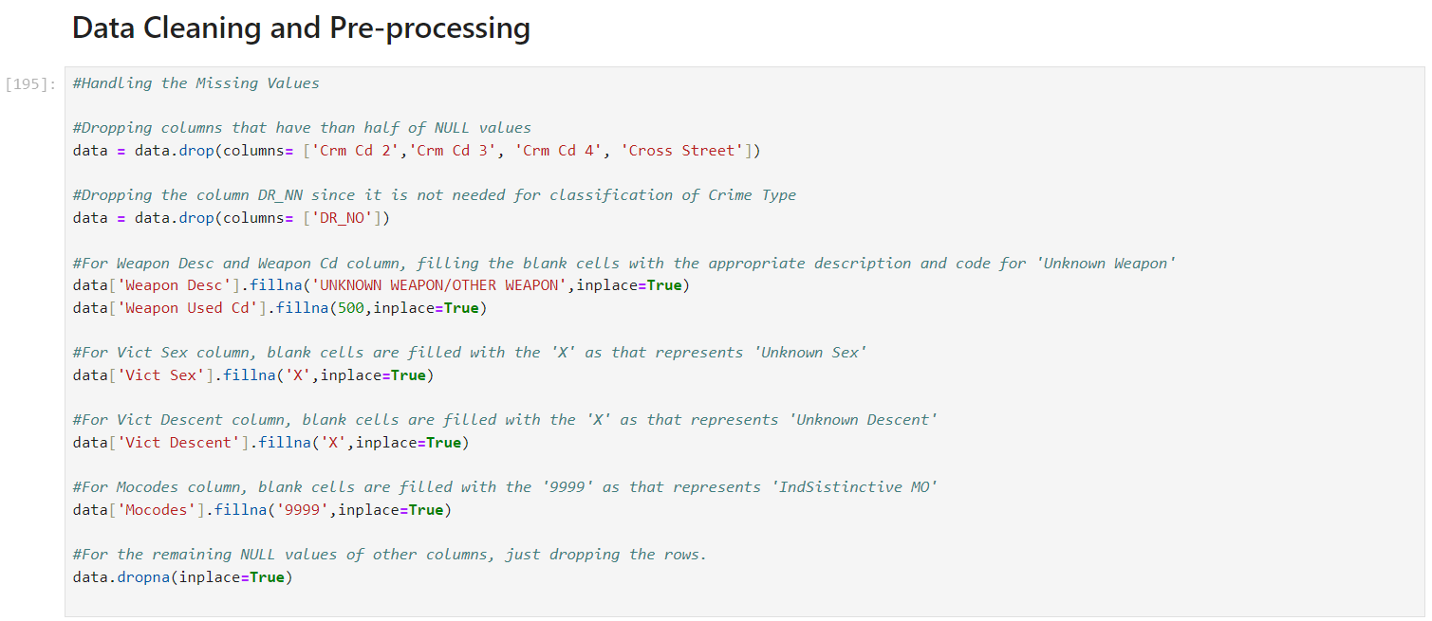
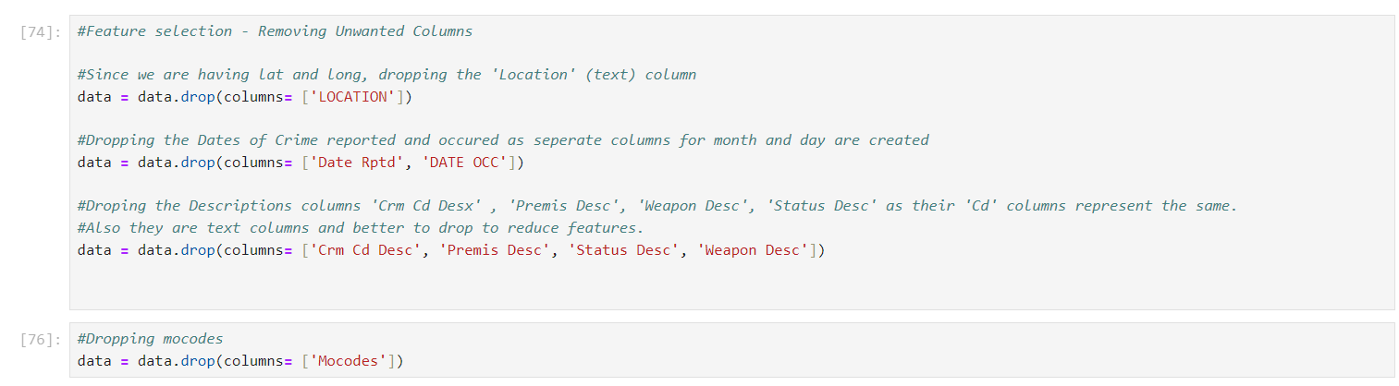

Slide 9
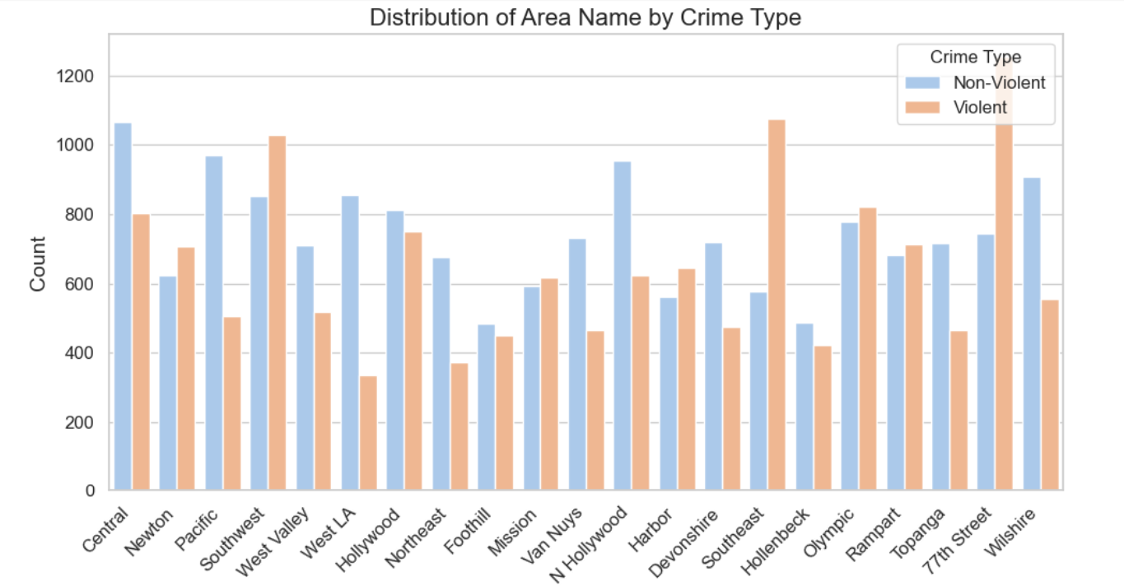
ANALYSIS OF FEATURES - EDA
Comparison of Violent and Non-Violent Crime Incidents Across Different Areas

Slide 10
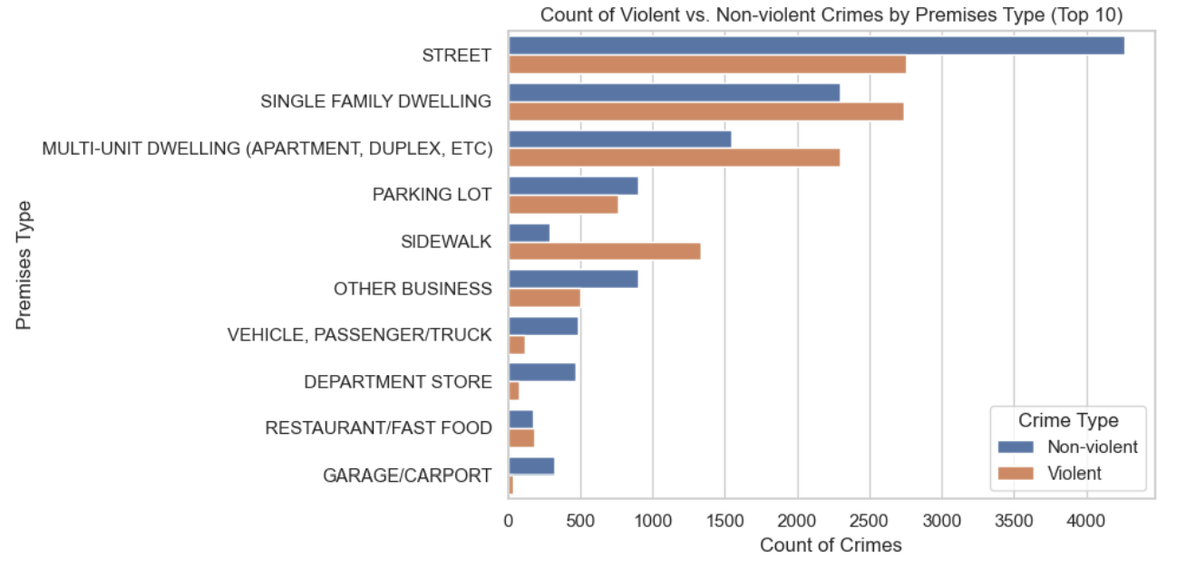
Violent Versus Non-violent Crime Distribution by Premises Type

Slide 11
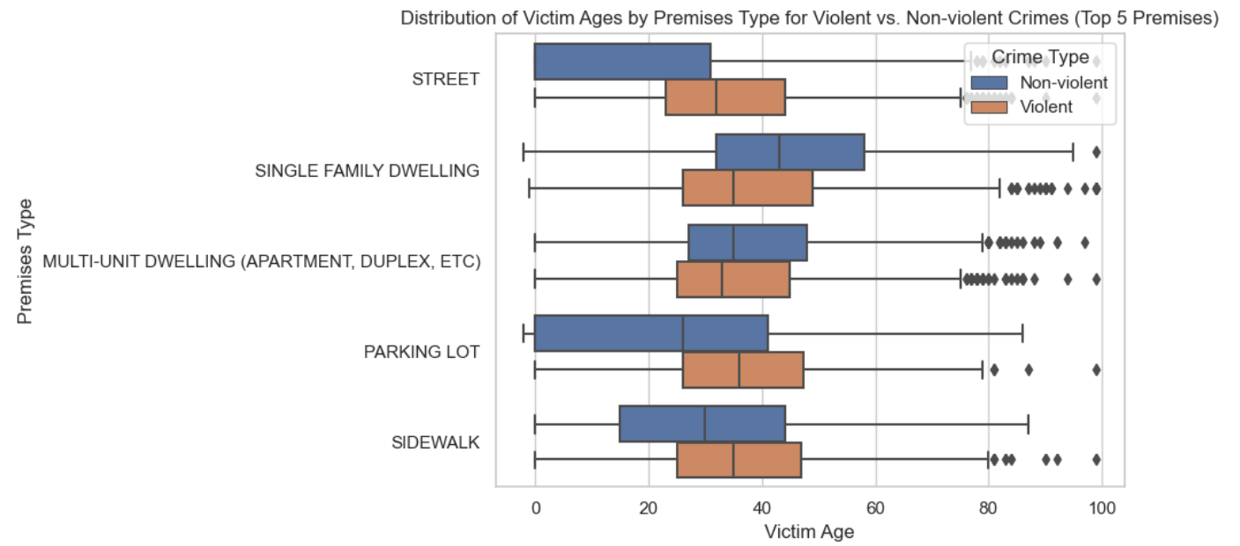
Age Profile of Crime Victims by Premises Type for Violent and Non-Violent Incidents

Slide 12
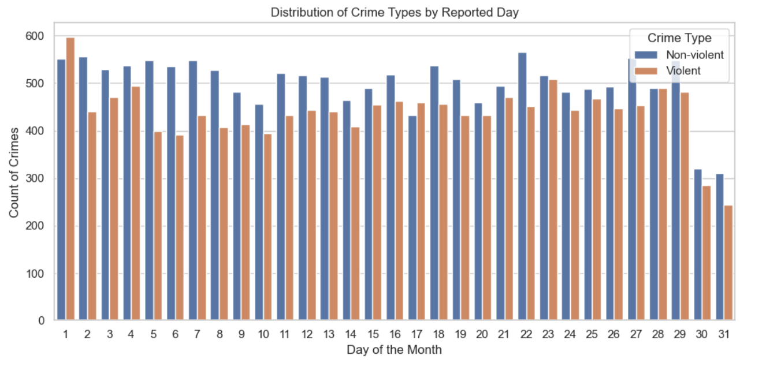
Daily Distribution of Violent Versus Non-violent Crimes Within a Month

Slide 13
Feature Selection
Crime Type encoded as binary for model compatibility (Violent = 1, Non-violent = 0).
Separated features into numerical and categorical for targeted preprocessing.
Numerical Column Selection Selected via Pearson's correlation (threshold, e.g., >0.1).
Categorical Column Selection: Chosen with chi-squared test (p-value <0.05).
Imputed missing values with median, applied z-score normalization and missing categories with mode, converted via one-hot encoding.
Employed ColumnTransformer to streamline preprocessing for both data types.
Split data into 80% training and 20% testing sets for model evaluation.

Slide 14
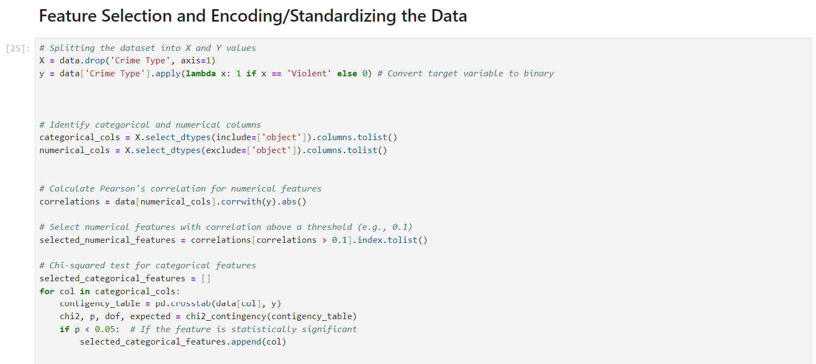
Feature Selection

Slide 15
Model Creation and Evaluation
Comparative Model Performance Analysis
Logistic Regression
Accuracy: 87.83%
High precision (90.74%) and good recall (82.59%)
Balanced F1 Score
Linear assumption may limit complexity handling
K-Nearest Neighbors (KNN)
Accuracy: 87.95%
Better at detecting violent crimes (Recall: 85.55%)
Slightly lower precision (88.49%) indicates more false positives
Sensitive to data scale and irrelevant features
Decision Tree
Accuracy: 89.06%
Highest precision (91.22%) and excellent F1 Score
Lower recall than KNN; may miss more actual violent crimes
Random Forest
Accuracy: 89.94% (best among all)
Highest recall and F1 Score; robust general performance
Complex model, requiring more resources and less interpretability

Slide 16
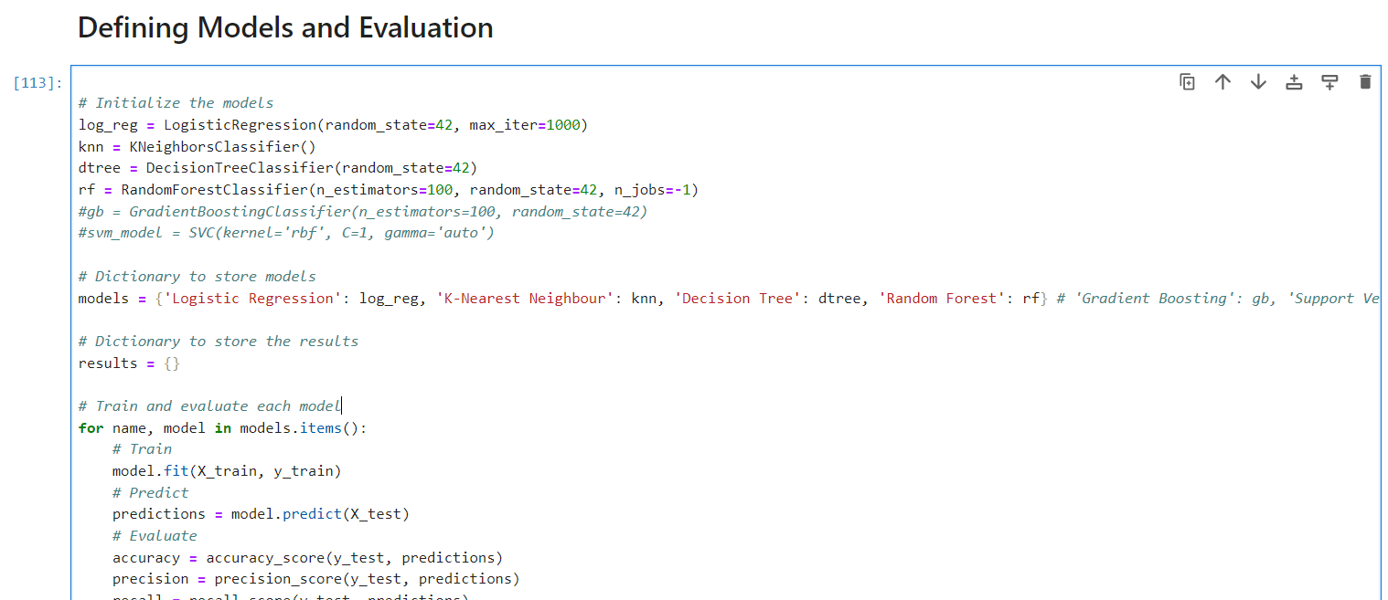
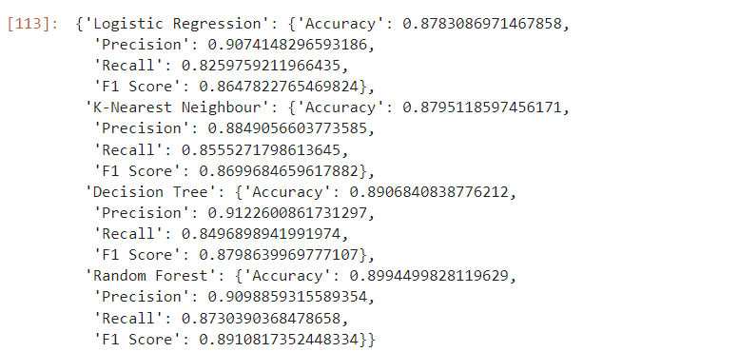
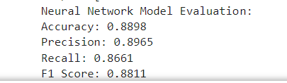

Slide 17
Comparative Model Performance Analysis
Best Model
Random Forest outshines others, excelling in all metrics—ideal for complex pattern datasets.
Precision-Recall Trade-off
Decision Tree leads in precision; however, it may overfit.
Random Forest strike a balance between precision and recall.
Complexity vs. Interpretability
Random Forest offers complexity at the cost of interpretability.
Logistic Regression is most interpretable but less adept at handling complexity.
Feature Interaction
Model performances vary with feature dependencies and relationships.
Logistic Regression and KNN are sensitive to feature scale; Decision Trees and Random Forest manage non-linearities better.
Context-Driven Model Selection
Random Forest for capturing intricacies.
Logistic Regression where interpretability and efficiency are crucial.

Slide 18
Hyperparameter Tuning - Optimizing Model Parameters
KNN Fine-Tuning
Grid Search CV: 60 fits, 12 candidates, 5 folds
Best accuracy: 88.75% with Euclidean distance, 7 neighbors, and distance-weighted votes.
Decision Tree Fine-Tuning
Grid Search CV: 120 fits, 24 candidates, 5 folds
Top accuracy: 91.72% using Gini index, max depth of 10, and min 10 samples split
Random Forest Fine-Tuning
Grid Search CV: 60 fits, 12 candidates, 5 folds
Highest accuracy: 91.56% with 20 max depth, 50 estimators
Overall Insights
Tuning improves generalization; ensemble methods show superior accuracy.
Decision Tree tops after tuning, yet may not generalize as well as Random Forest.
Random Forest's robustness to variance makes it preferred for crime prediction.

Slide 19



Hyperparameter Tuning - Optimizing Model Parameters

Slide 20
Random Forest – Tuned for Precision
Optimized Model Parameters
Max Depth: 20
Estimators: 50
Achieves high accuracy and predictive reliability.
Performance Metrics
Accuracy: 90.24% – Reliable overall classification.
Precision: 92.59% – Low false positive rate, critical in law enforcement.
Recall: 86.17% – Effectively identifies a majority of violent crimes.
F1 Score: 89.27% – Indicates balanced precision and recall.
Evaluation Insights
High precision minimizes the risk of misclassifying non-violent crimes.
Sufficient recall for detecting potential violent incidents.
Harmonized F1 score underscores the model's balanced performance.

Slide 21
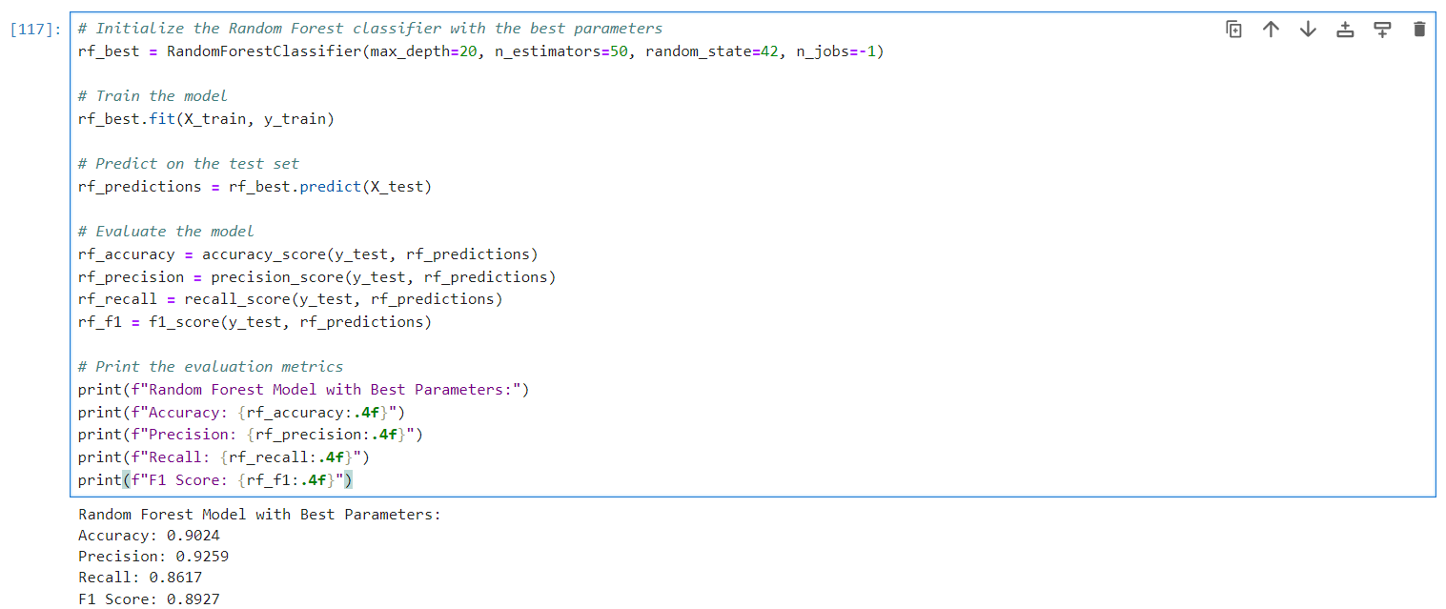
Random Forest – Tuned for Precision

Slide 22
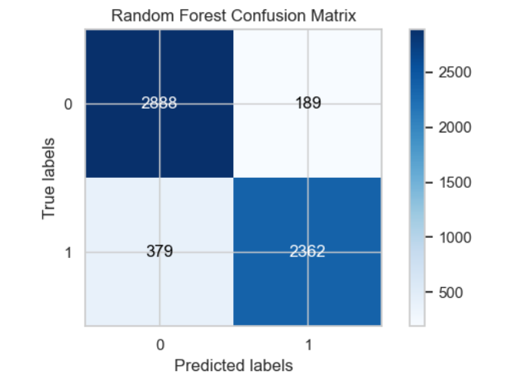
Confusion Matrix – Tuned Random Forest
High true positives/negatives affirm model reliability in crime classification.
Only 189 false positives, indicating cautious violent crime predictions.
379 false negatives warrant focus to enhance model's predictive capabilities.
2,362 true positives highlight the model's potential in aiding crime prevention.
Confirmed high precision and recall, evidencing balanced detection of violent crimes.
F1 score and confusion matrix balance reflect a robust predictive model.

Slide 23
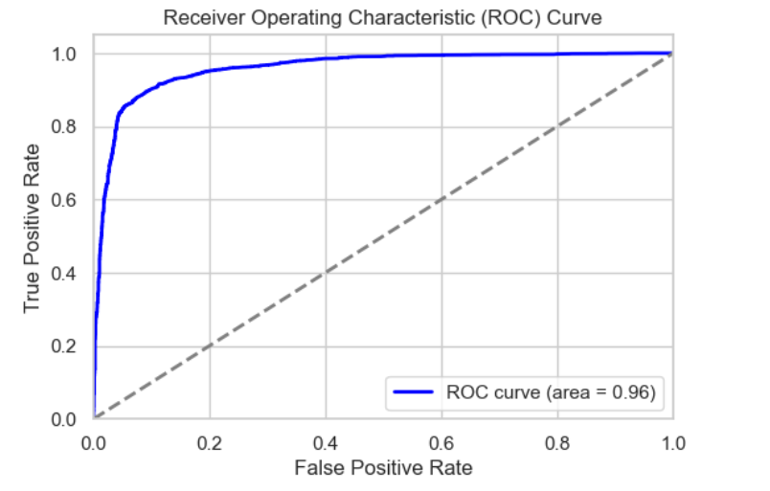
ROC Curve – Tuned Random Forest
ROC Curve Insights:
AUC of 0.96 denotes high separability and accurate class distinction.
Curve closely follows the top left corner, indicating optimal model performance.
Enables selection of an optimal threshold for balancing sensitivity and specificity.
Confidence in model reliability due to high likelihood of correct positive prioritization.

Slide 24
Conclusion
Modeling Objective
Successfully applied Supervised ML algorithms to classify crimes as violent or non-violent.
Comprehensive Evaluation
Performance measured by accuracy, precision, recall, F1 score.
Hyperparameter Optimization
Utilized Grid Search for enhancing model accuracy and reliability.
Model Superiority
Random Forest outperformed with top accuracy and an excellent F1 score.
ROC Analysis Validation
AUC score of 0.96 affirms Random Forest’s discriminative effectiveness.
Operational Application
Proven model precision and recall suitable for real-world predictive policing initiatives.

Slide 25
THANK YOU!

